Slide 1
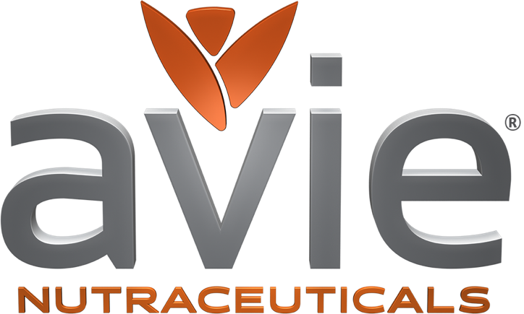
Notes:
This is slide can be waiting on screen. Verbal presentation starts with the next slide.

Slide 2
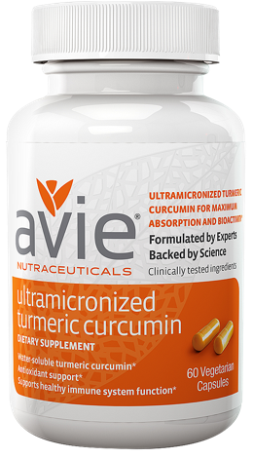
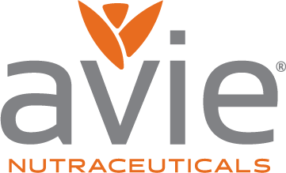
Notes:
This is a short presentation to introduce you to the Avie Curcumin advantage. More sales in a growing category.
(CLICK)
And proven benefits to your customers.

Slide 3
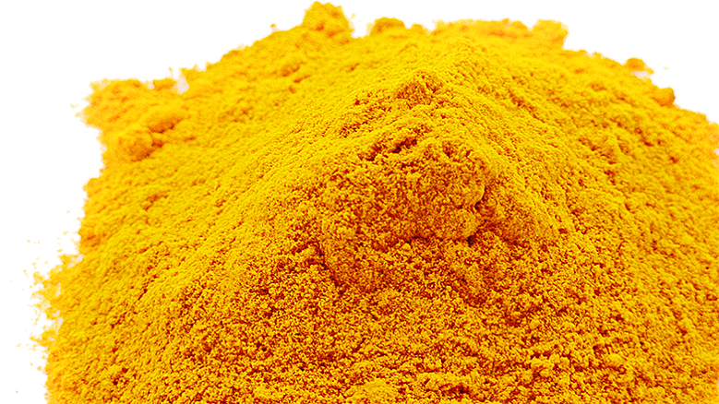
Curcumin is a clinically-proven aid for
Anti-inflammation and joint mobility
Brain function and memory
Anti-oxidant protection of cells from free radical damage
Improved appearance of skin and hair
Removal of toxins from the body
Liver function
Healthy immune system
Healthy digestion
Notes:
No wonder turmeric’s active ingredient has been used in traditional Asian/Ayurvedic medicine for thousands of years. It works.

Slide 4
Notes:
But not all curcumins are created equal

Slide 5
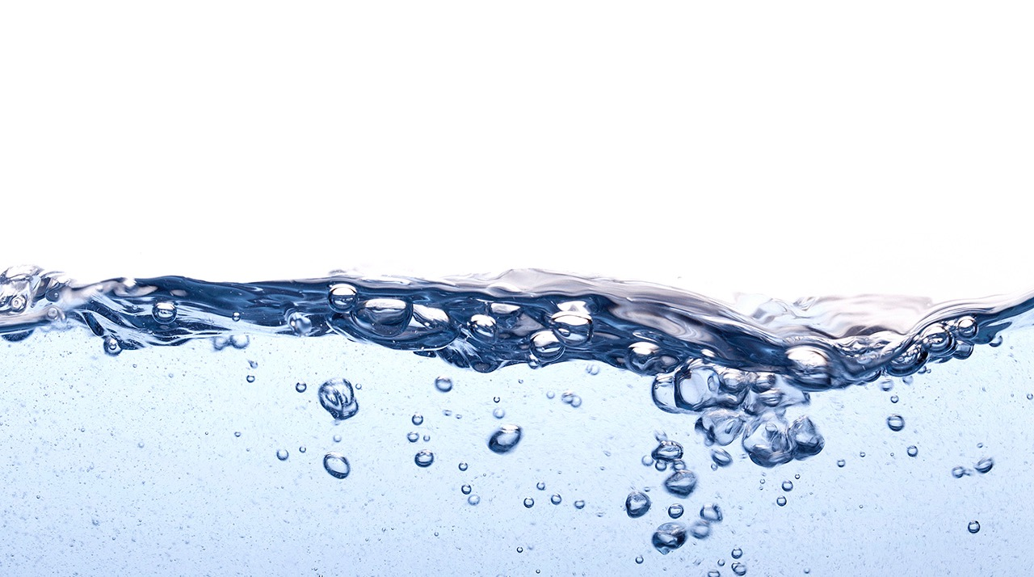
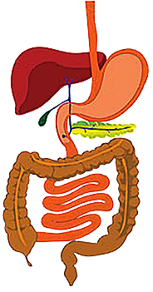
The digestive system is a hydrophilic environment
Hydrophilic: soluble in water

Slide 6
Curcumin/Turmeric is not soluble in water
Notes:
But the curcumin on your shelves is not soluble in water.

Slide 7
Poor absorption through intestines
when taken orally
90% is excreted
Poor bioavailability
Poor bioactivity

Slide 8
AVIE® solved the problem: Only AVIE® Turmeric is
WATER SOLUBLE
Notes:
We created the first water-soluble curcumin.

Slide 9
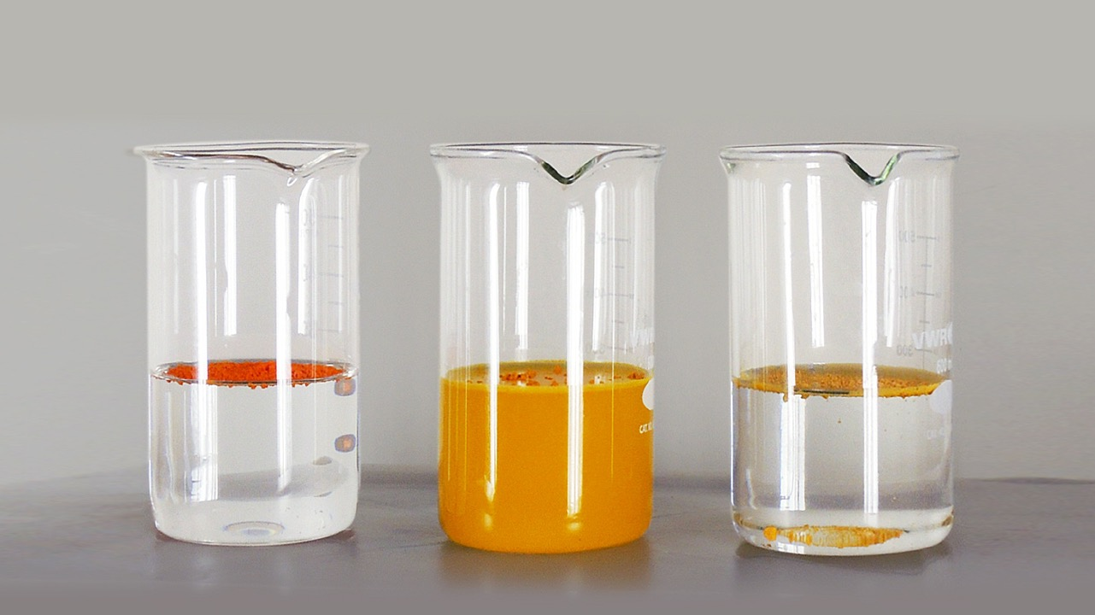
BRAND X
C3 Complex®
BRAND Y
BCM-95®
Notes:
See what happens when two of our leading competitors are added to water,
(click)
While Avie Ultramicronized Curcumin fully dissolves.

Slide 10
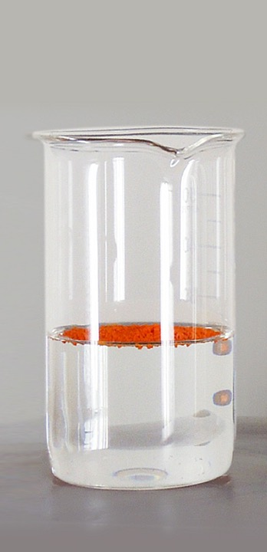
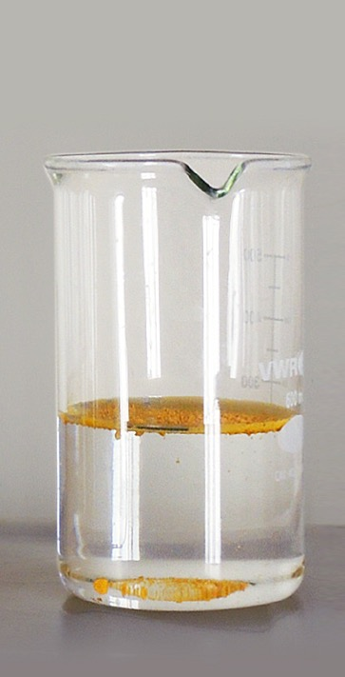
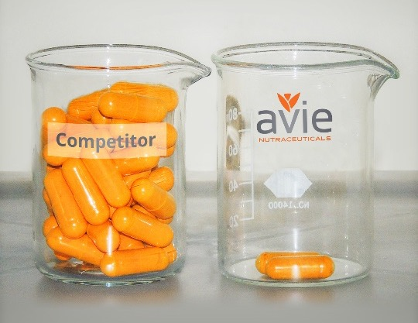
2% effective
BRAND X
C3 Complex®
BRAND Y
BCM-95®
Insoluble in water
Poor bioavailability
Poor bioactivity
30 capsules required for pain relief
Notes:
The result is that it takes an incredible amount of curcumin to achieve results.

Slide 11
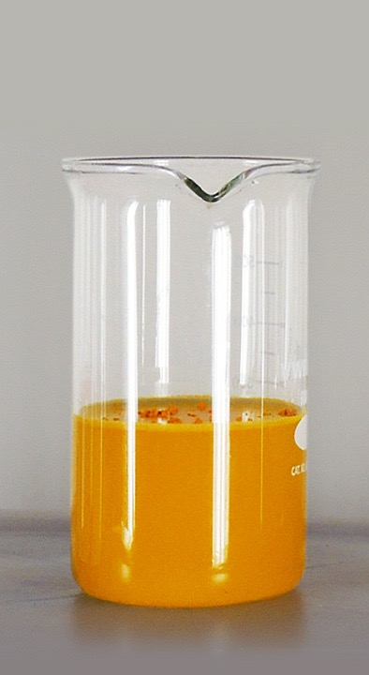
Avie® water-soluble formulation
Full absorption through intestines after oral intake
Maximum bioavailability
Maximum bioactivity
2
capsules required for pain relief
Notes:
…as compared to just two capsules of Avie Ultramicronized Curcumin.

Slide 12
™
Notes:
Avie turned to a process called ultramicronization that unlocks curcumin’s water-soluble properties.

Slide 13
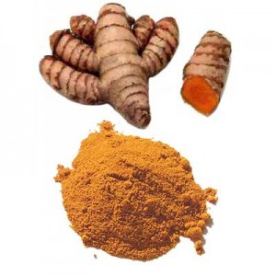
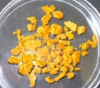
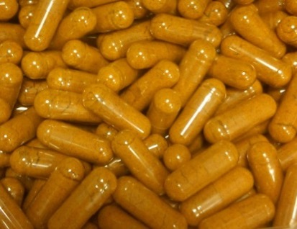
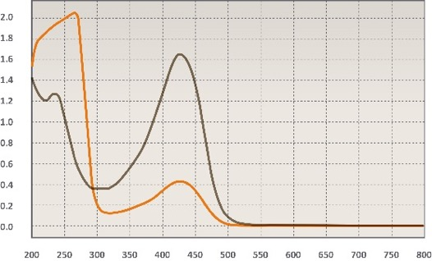
Ultramicronization process transforms turmeric.
Extraction
Microniziation
Encapsulation
Quality Control
Notes:
Our process was formulated by experts and backed with science.

Slide 14
Dried Turmeric Extract
extraction
Turmeric Root
Notes:
High quality raw turmeric is room is dried and concentrated.

Slide 15
Dried Turmeric Extract
Ultramicronization™
Ultramicronized Turmeric Extract
Notes:
Then it undergoes our unique Ultramicronization process.

Slide 16
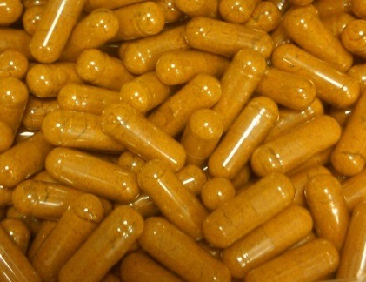
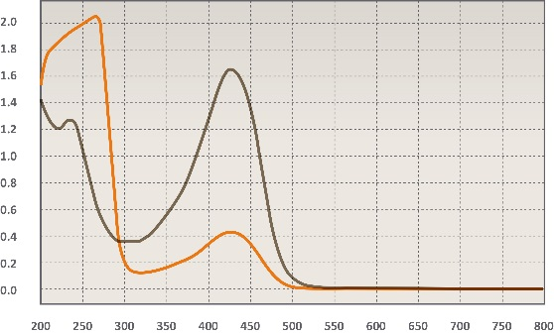
Encapsulation
Quality Control
Notes:
Our capsules are meticulously checked and tested…

Slide 17
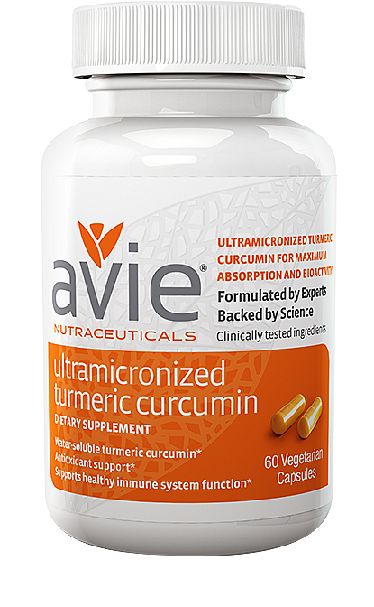
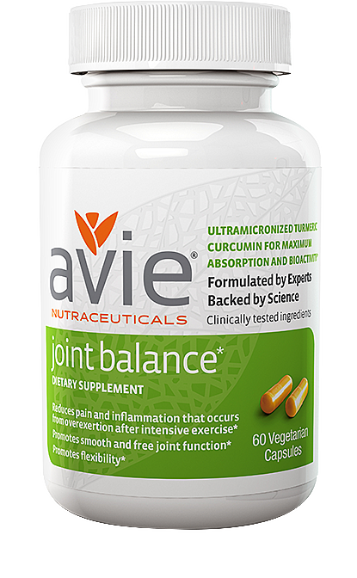
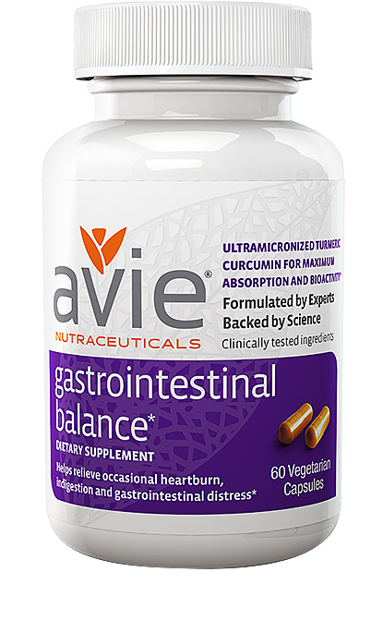
Notes:
And offered as ultramicronized curcumin only, as well as Joint Balance and Gastrointestonal Balance formulations.

Slide 18
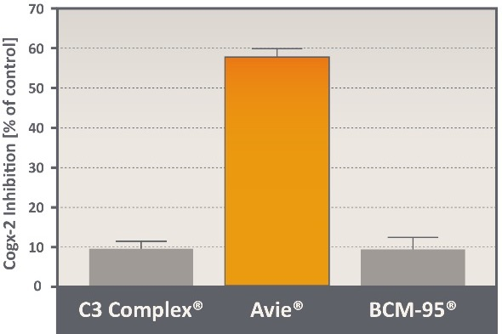
Ultramicronization™ = biological potency
Anti-inflammatory potency
Cox-2 Inhibition [% of control]
126
fold potency increase
Notes:
The Avie advantage increases curcumin’s anti-inflammatory powers.

Slide 19
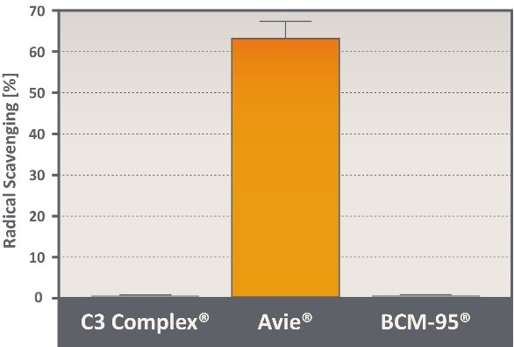
Ultramicronization™ = biological potency
Anti-inflammatory potency
Radical Scavenging potency
1400
fold potency increase
Notes:
Vastly boosts its ability to combat free radicals.

Slide 20
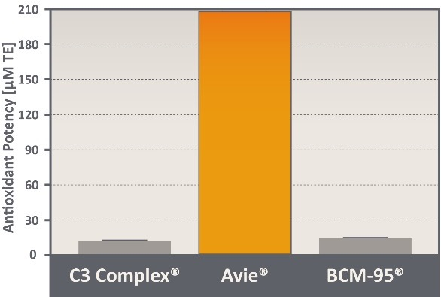
Ultramicronization™ = biological potency
Anti-inflammatory potency
Radical Scavenging potency
Antioxidant potency
350
fold potency increase
Notes:
And increases its antioxidant properties compared to the curcumin you are now selling.

Slide 21
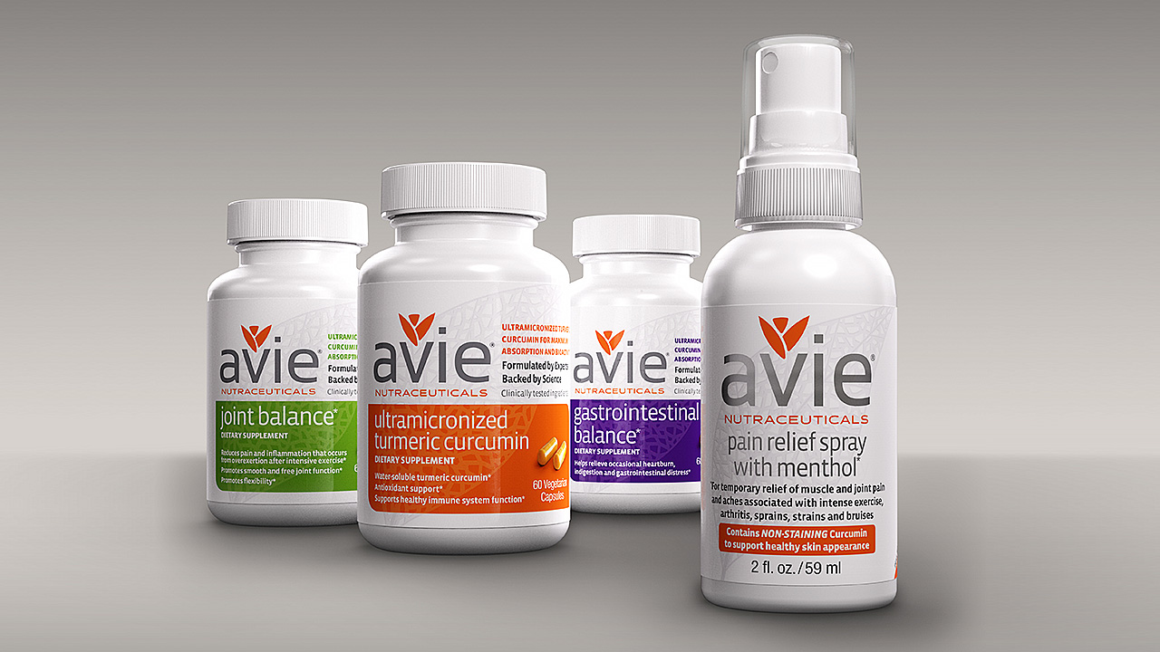
Notes:
Avie isn’t a packager of hundreds of different bulk herbal supplements. We’re a company founded by research scientists who specialize in a few clinically proven solutions.

Slide 22
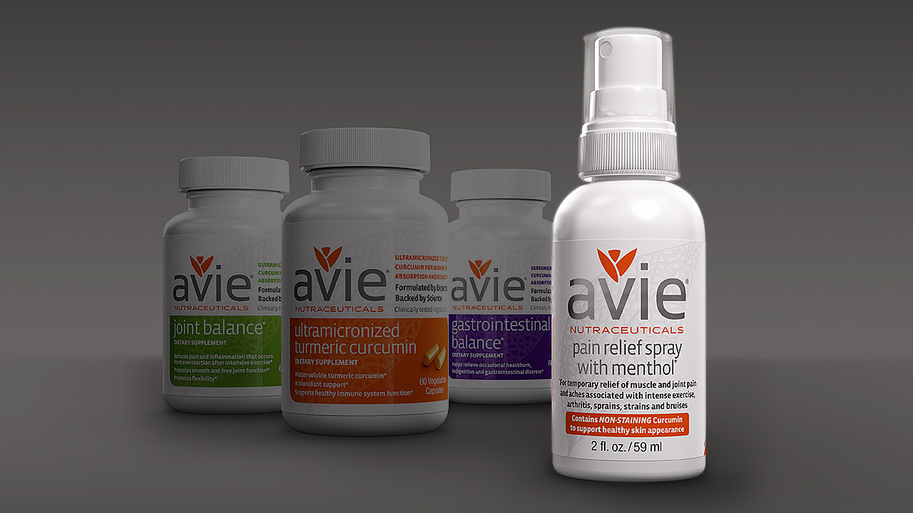
Notes:
…including a new curcumin pain relief spray with menthol.

Slide 23
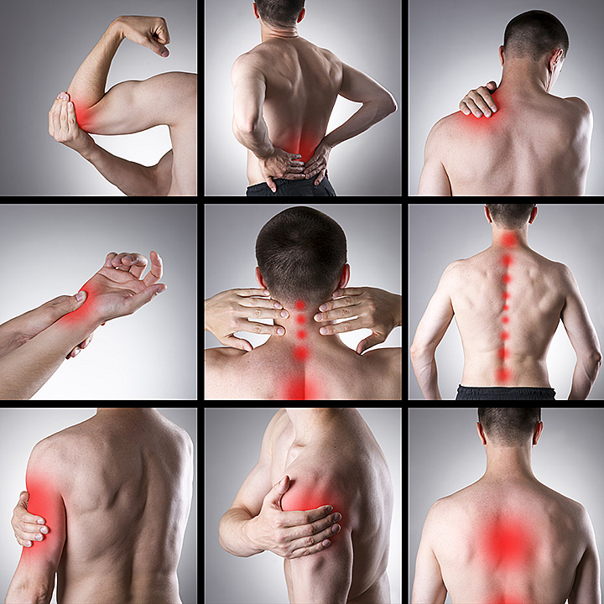
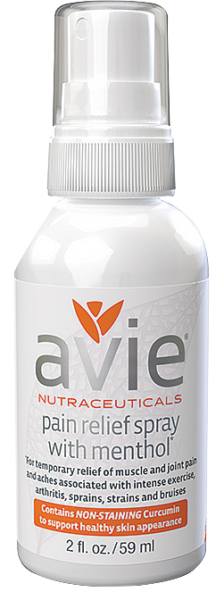
Pain Relief Spray Aspirin Free
Fast penetrating – no patches or greasy ointments
Goes to work and dries immediately on contact
Quick response and relief of muscle and joint pain after intense exercise, arthritis, sprains, bruises or aches from heavy household work or gardening
Joint mobility and flexibility
Reduced inflammation
ASPIRIN FREE
Optimum results when used with AVIE® Ultramicronized Turmeric Curcumin or Joint Balance capsules
Notes:
Our spray with non-staining curcumin provides temporary relief of muscle and point pain without the use of aspirin, ibuprofen or naproxen.

Slide 24
Notes:
We want to bring the Avie advantage to your store and customers.

Slide 25
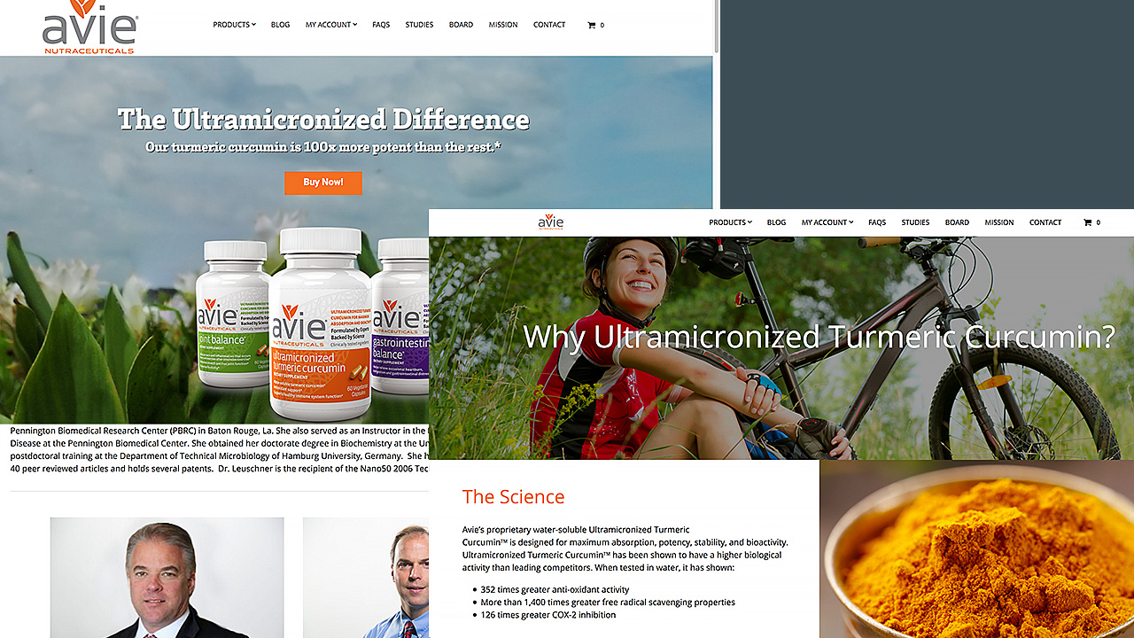
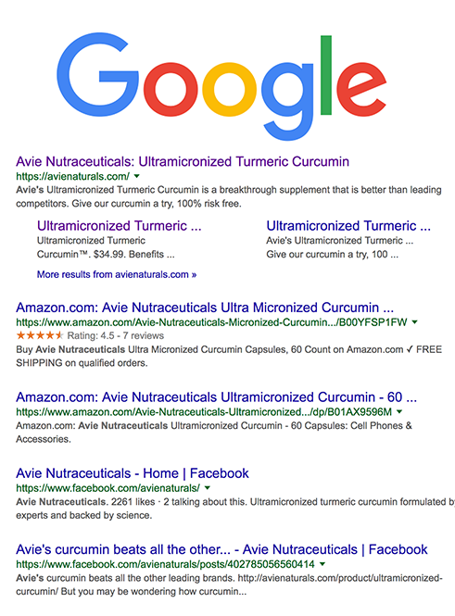
AvieNaturals.com
Notes:
Our mobile-friendly web site is supported by paid search.

Slide 26
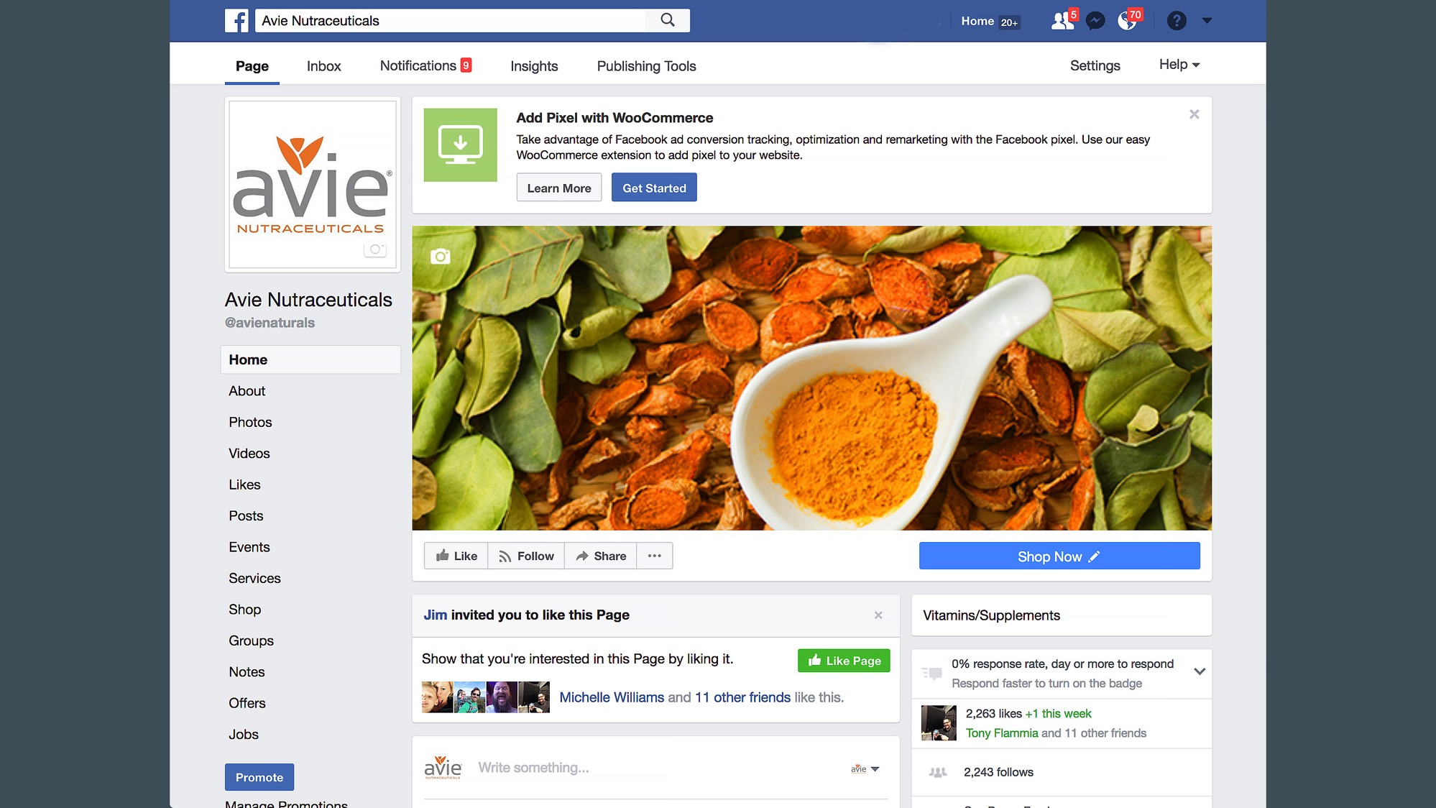
Notes:
We have an active Facebook following…

Slide 27
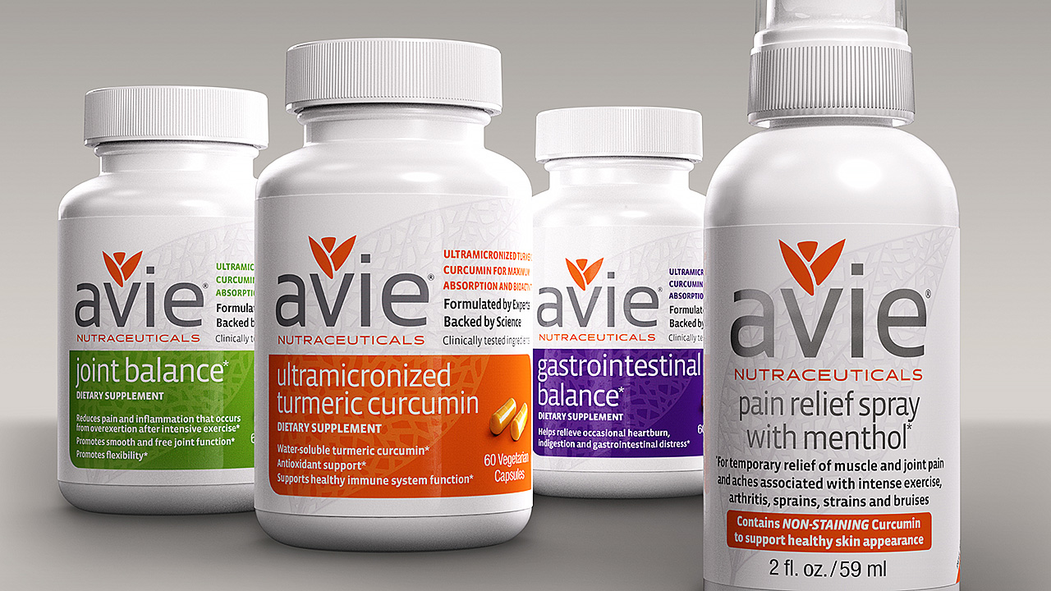
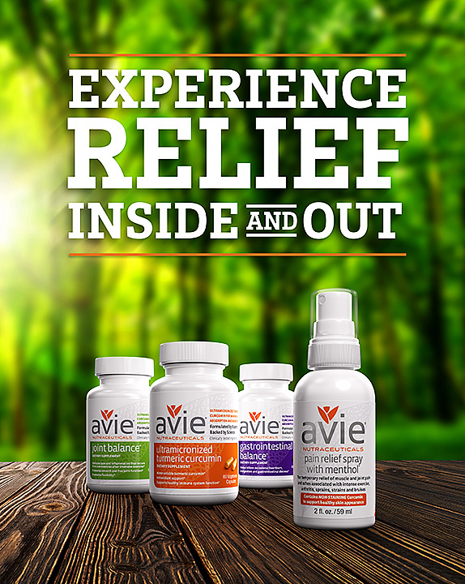
Notes:
…as well as attractive packaging and POP.

Slide 28
Notes:
I hope that this market has demonstrated to you that there really IS an Avie advantage.

Slide 29
Notes:
We’d like your business.
Thank you for your time and attention.

Slide 30
Notes:
END OF PRESENTATION

Slide 31
What follows is a supplementary “loop” of slides with further information on curcumin and turmeric. They are accessed from the at the upper right corner of Slide 3.
?
Notes:
What follows is a supplementary “loop” of slides with further information on curcumin and turmeric. They are accessed from Slide 3.

Slide 32
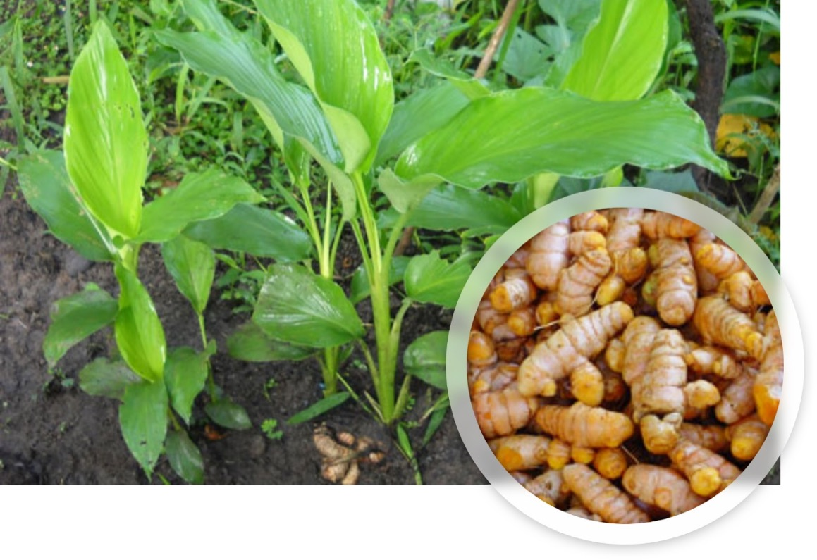
Curcumin originates from the Turmeric plant root.
Turmeric Plant (Curcuma longa)
Spice and food coloring
Traditional medicine for more than 5,000 years treating inflammation, infection, pain and GI conditions
Extracts were prepared by boiling roots in water to gain solubility
Curcumin is the active ingredient in turmeric
Turmeric Plant
(Curcuma Longa L)
Turmeric Root
Notes:
For over 5000 years Eastern medicine has been aware of the positive properties of turmeric and its active ingredient, curcumin..

Slide 33
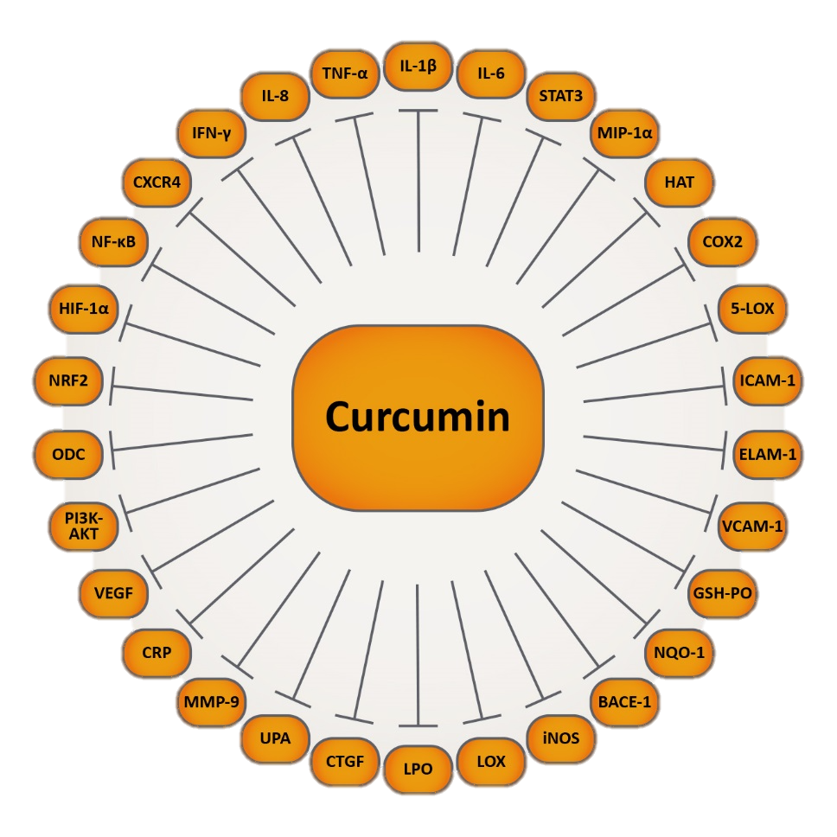
Scientifically proven properties of curcumin
Anti-inflammatory and anti-oxidant properties translate into multiple benefits in a number of chronic conditions
Neurological diseases (Parkinsons and Alzheimers, multiple sclerosis, epilepsy, cerebral injury, neuropathy)
Cardiovascular diseases (atherosclerosis)
Allergies
Bronchitis, colitis
Rheumatoid arthritis
Renal ischemia
Psoriasis and psoriatic arthritis
Diabetes
Wound-healing
Anti-microbial properties
Aggarwal BB and Harikumar KB, Int J Biochem Cell Biol. 2009 ; 41(1): 40–59.
Notes:
Contemporary medical research has confirmed that curcumin is a powerful anti-inflammatory and anti-oxidant.

Slide 34
Inflammation and its treatment using pharmaceuticals vs. Turmeric formulations
Long term use of Aspirin, Ibuprofen, Naproxen, Tylenol | Long term use of Turmeric
Gastrointestinal bleeding, liver damage, heart attack and stroke | No known toxicities, GI and Liver protection
70 million Americans regularly use NSAIDs, resulting in clinically significant upper GI complications in up to 2% of users (1.2 million cases)
More than 80% of patients developing GI complications have no prior symptoms or warning signals (120,000 pa admissions) | GI and Liver protection
Central nervous system (CNS), hematologic, and dermatologic symptoms | Protection of Central nervous system (CNS), hematologic, and dermatologic symptoms
Notes:
It avoids the side effects of nonsteroidal anti-inflammatory drugs like ibuprofen and aspirin.
CLICK ON THE ARROW BUTTON TO CONTINUE WITH PRESENTATION

